Slide 1
Using the FLDPLN Model for Flood Inundation Mapping
Introduction to the FLDPLN FIM model
Use Wildcat Creek, KS Labor Day flood event as an example
Workshop materials
Notebooks, Python packages and tools are on GitHub
https://github.com/XingongLi/fldpln
fldpln_py, MATLAB Runtime installer (without MATLAB Runtime), fldpln and ArcGIS toolbox
Wildcat Creek data is on KU KBS-KARS server
DEMs, segment shapefiles, gauge data and reference FIM map
Installer with MATLAB Runtime included is on KU KBS-KARS server

Slide 2
Low Complexity FIM Models
Hydrodynamic models are more accurate but need more data and computational resources
Low complexity models are faster and need few inputs
Faster at high resolution over large areas
Hydro-conditioned DEM as the primary input
Especially useful in predicting inundation extent and depth that are likely to occur in the immediate future using observed or forecasted stream stage

Slide 3
The FLDPLN (floodplain) Model
Low-complexity flood inundation model based on backfill and spillover flooding mechanisms
Backfill
Flooding
Spillover
Flooding
water surface
Q
P
flow
water surface
d
flow
ground surface
ground surface
uphill flow
(swelling)
downhill flow
(overland flow)
}
d
P
Q
“Water seeks its own level”
“Water flows downhill”

Slide 4
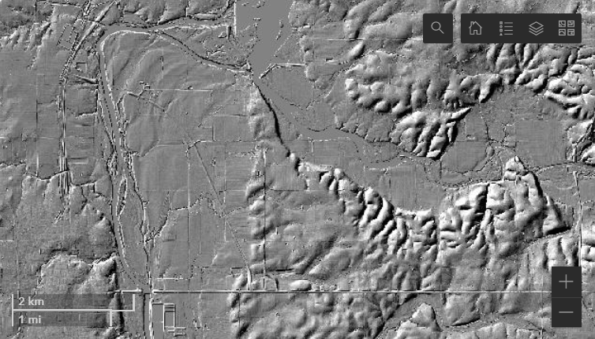
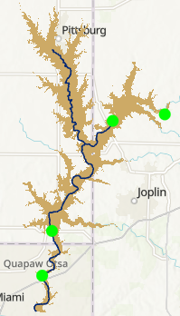
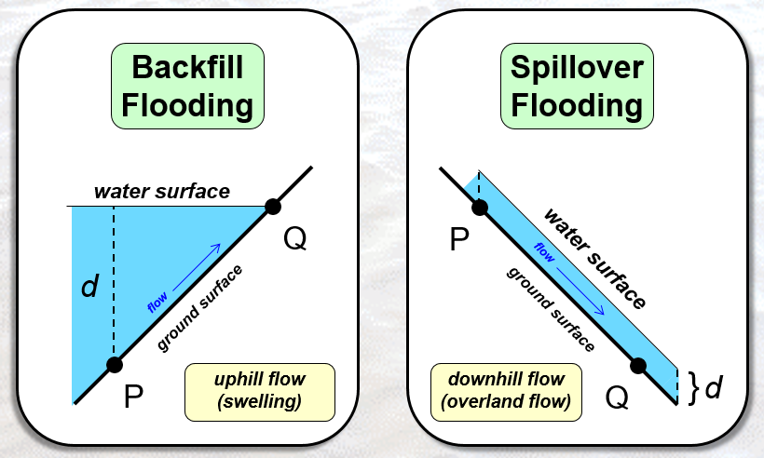
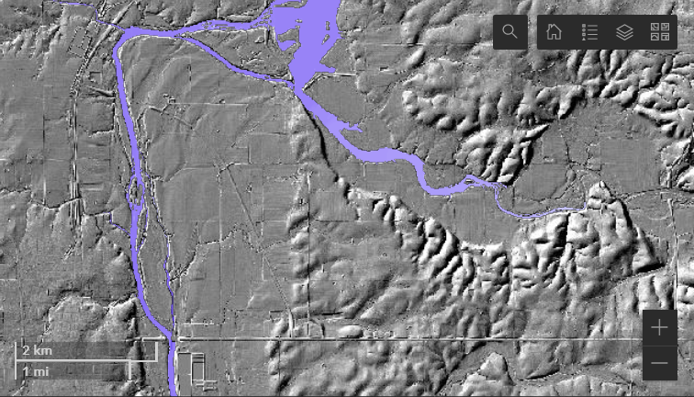
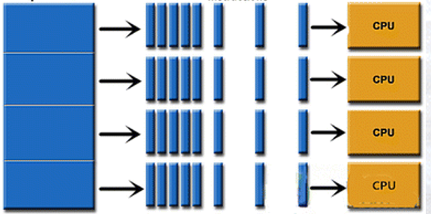
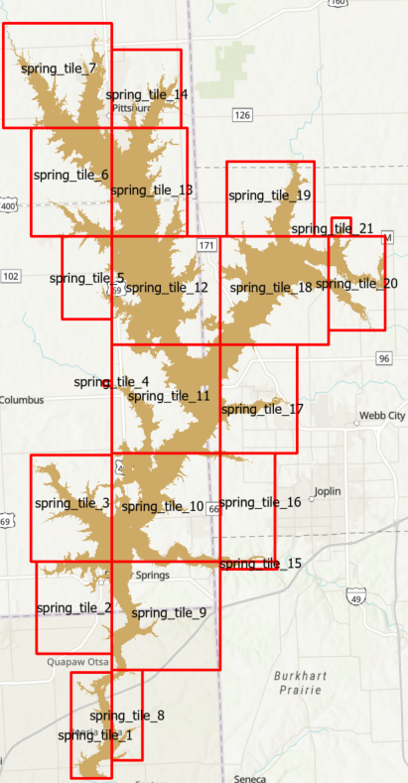
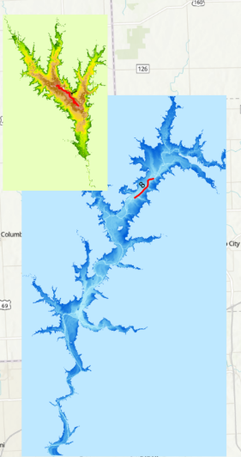
Major Processes
Hydro-conditioning DEM
FLDPLN inundation modeling
Segment to tiled libraries
Inundation mapping
FLDPLN

Slide 5
Hydro-Condition DEM
Processing of a DEM so that the flow of water is continuous across the terrain surface
Fill spurious sinks or pits
Add breach lines to drain sinks
Burning culverts into roads
Cut through bridges above river
Burning spillway into dam
Add flood defense (levees and flood walls) into DEM
Tools
GIS and DEM hydrological analysis tool (such as ArcGIS Hydrology toolbox or the ArcHydro extension)
Special tool (written in MATLAB script) to add flood defense into DEM

Slide 6
Prepare DEM and Its Derivatives
Tool to turn hydro-conditioned DEM raster (in GeoTiff format) into BIL rasters
fldpln preprocess model.atbx
Mask out large waterbodies

Slide 7
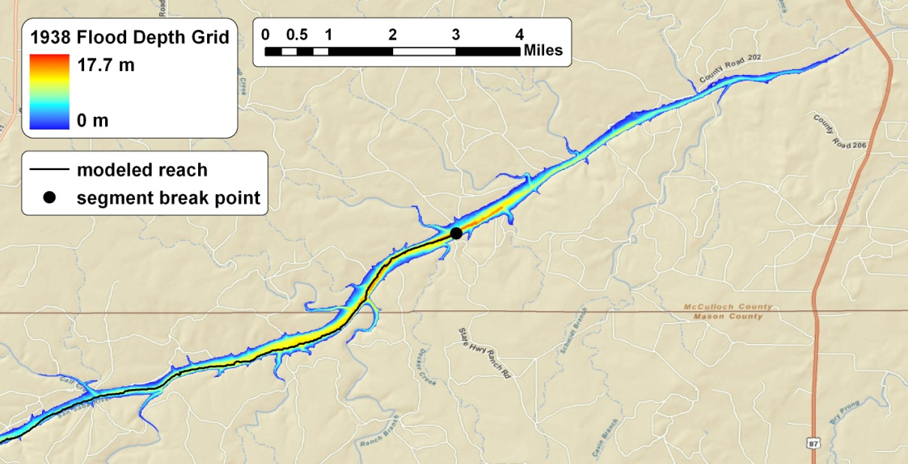
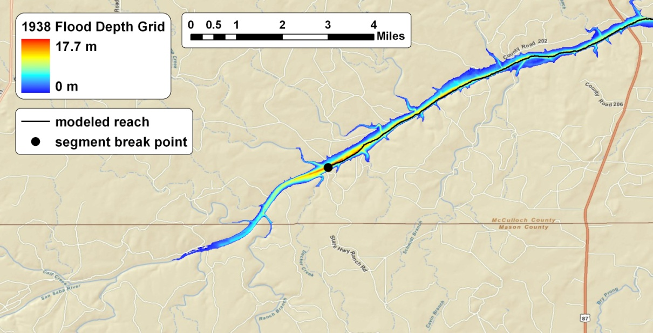
Segment-Based Modeling with FLDPLN
spillover taper
(depth decay)
upstream
segment
flow
downstream
segment
backfill taper
(lake effect)
flow

Slide 8
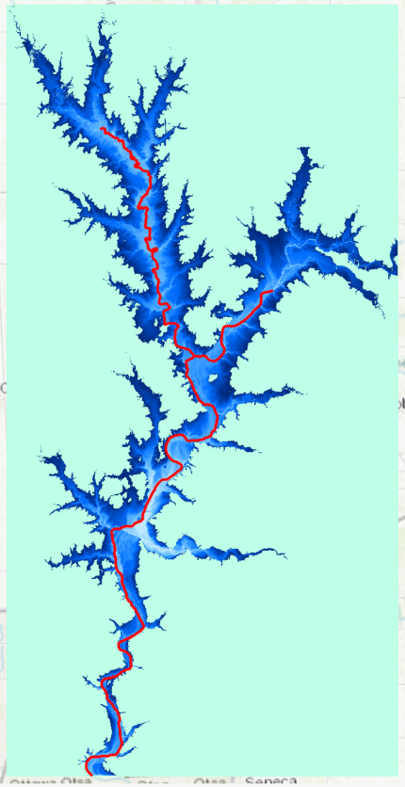
Flood Inundation Relations
A floodplain pixel (FPP) can be flooded by the water originated from flood source (stream) pixels (FSPs) through backfill and spillover flooding
FSP-FPP flood relation
many-to-many relation
Depth to flood (DTF)
Minimum depth at a FSP needed to flood a FPP
Attribute associated with a FSP-FPP relation
FLDPLN model identifies the FSP-FPP flooding relations and their associated DTFs
Iterative process
5
(DTF)
3
(FPP)
1
(FSP)

Slide 9
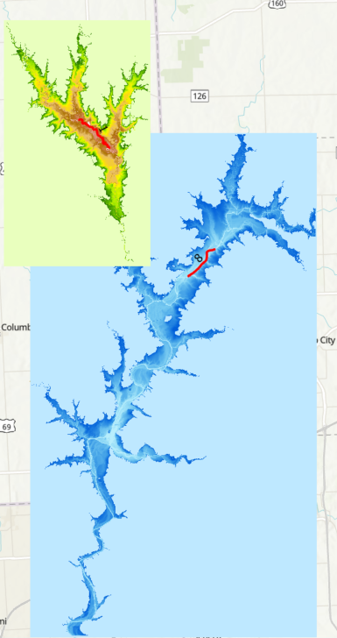

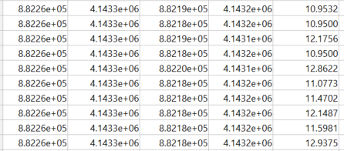
Tile FSP-FPP Inundation Relations
Organize relations by tiles
Each tile stores all the FSPs that can flood the FPPs in the tile
Flood mapping by tiles
Avoid memory overflow with a proper tile size
Only one file I/O is needed to map a tile
Scalable
Mapping tiles in parallel
Each tile can be mapped independently

Slide 10
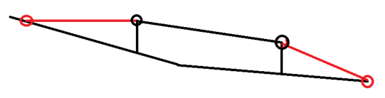
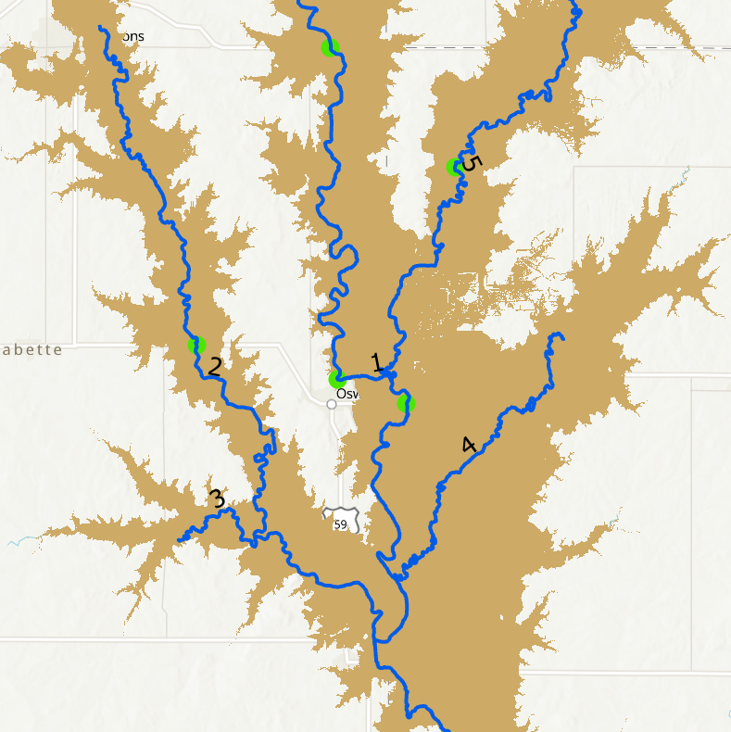
Flood Inundation Mapping
Estimate FSP depth of flow (DOF) from gauge observation or forecast
Snap gauges to FSPs
Based on steam orders
From low to high
Linear interpolation using
distance or elevation
Stage sources
NWS AHPS and USGS
NWM + HAND SRC

Slide 11
Inundation Mapping
Interpolated FSP DOF
A FPP is flooded by a FSP if its DOF > DTF
FloodDepth_{FSP(i)} = DOF_{FSP(i)} - DTF_{FSP(i)}
Flood depth at a FPP
max(FloodDepth_{FSP(1)}, …, FloodDepth_{FSP(n)})
N is the number of FSPs that flood the FPP
Example
Flood depth = max((5-3), (7-1)) = 6
3
5
3
5
1
7

Slide 12
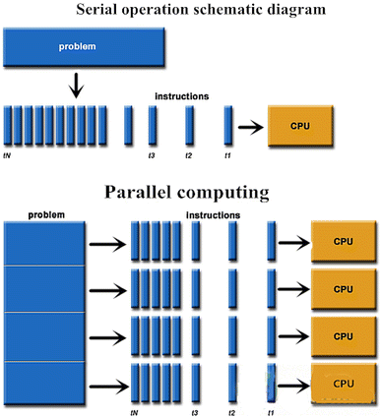

Parallel Inundation Mapping
Time sensitive application
Tiled libraries ready for parallelization
Dask with custom directed acyclic graph (DAG)

Slide 13
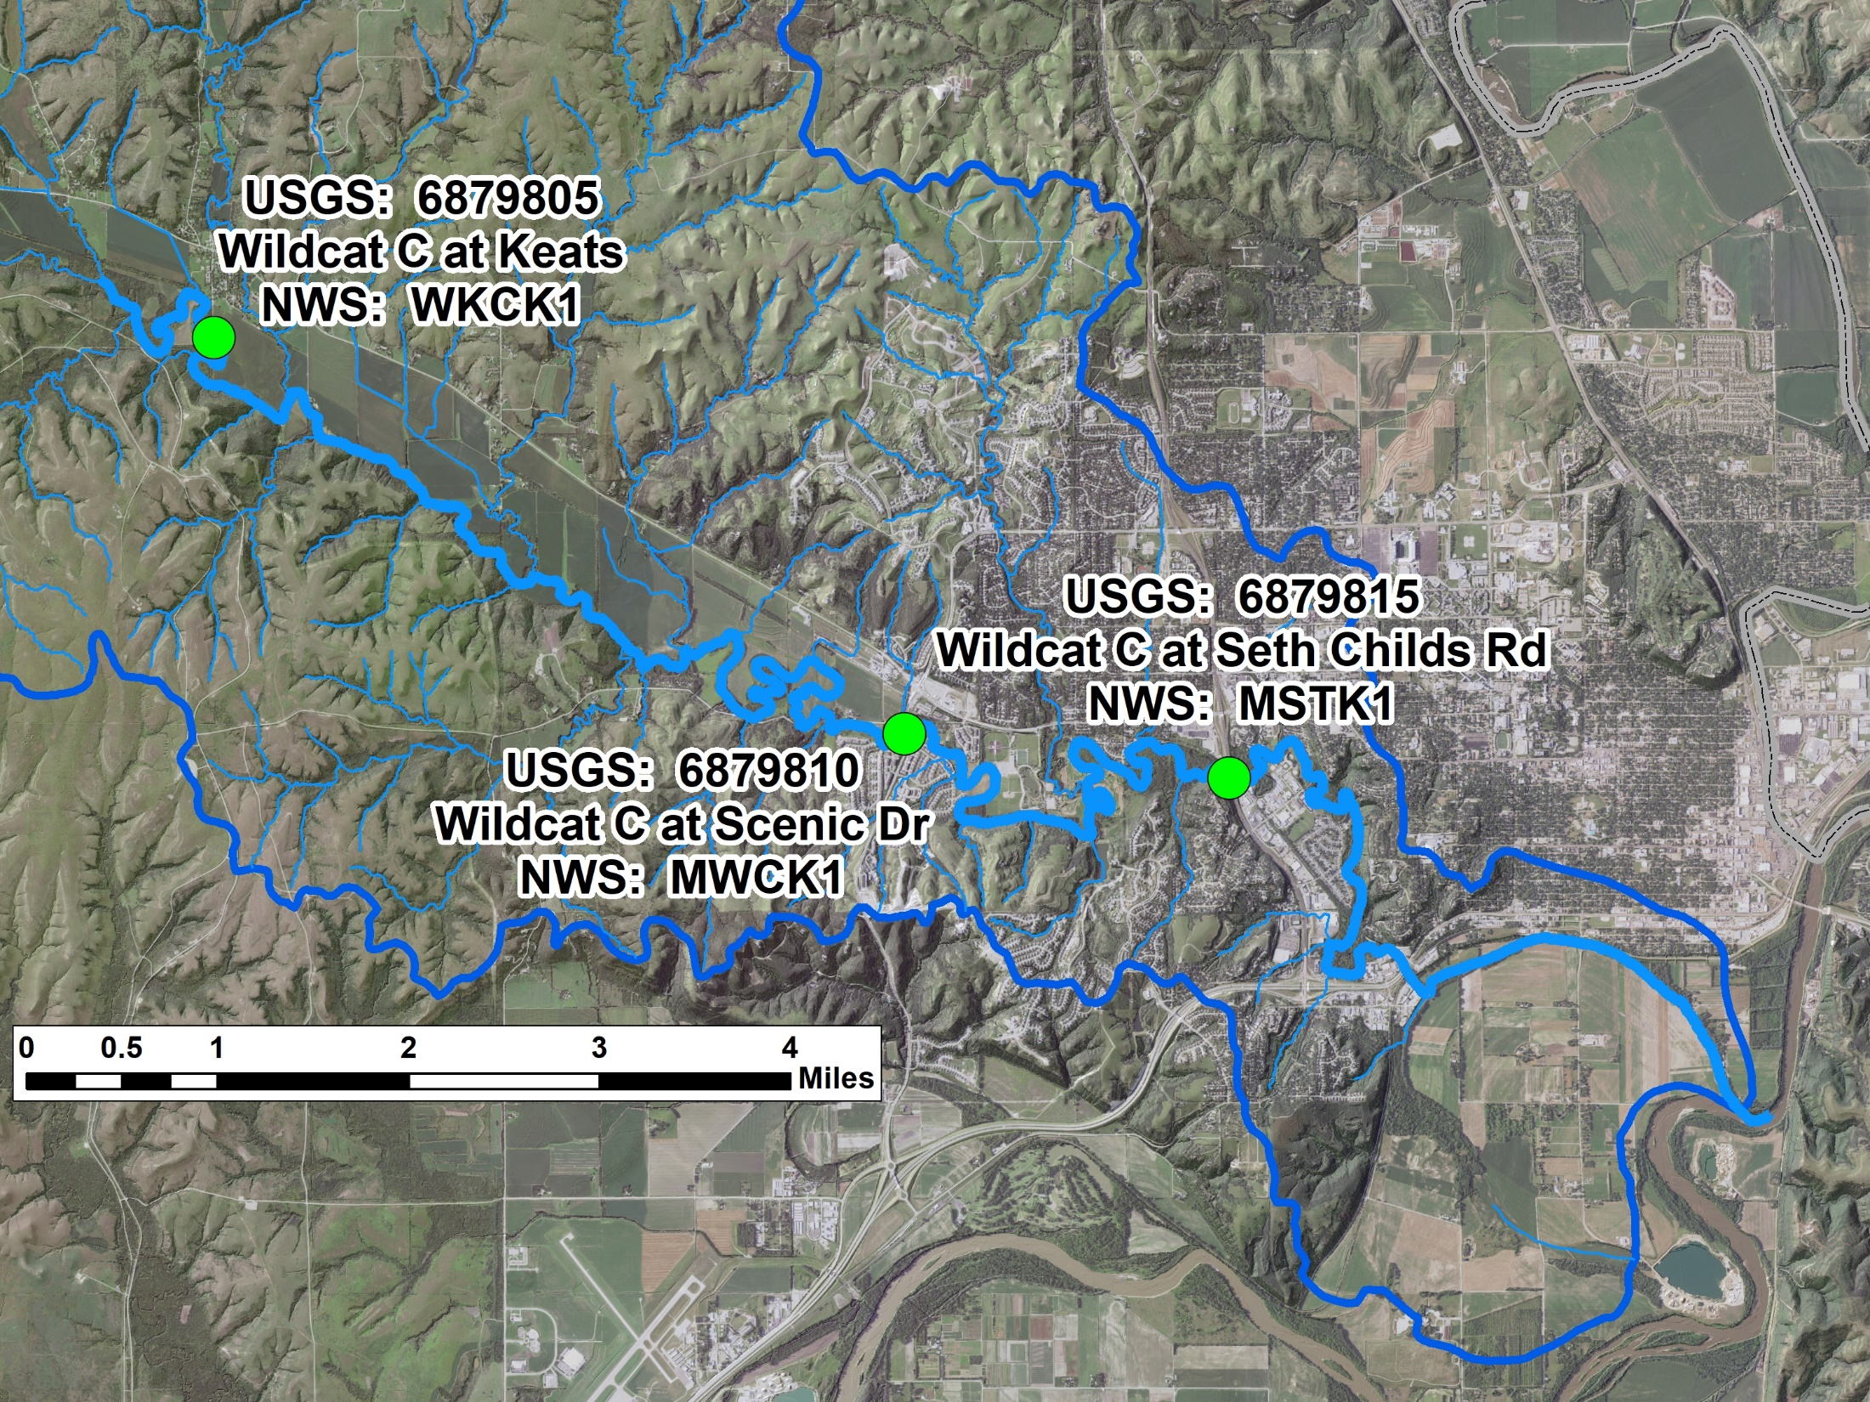
Mapping Sep. 3, 2018 Wildcat Creek Flood

Slide 14
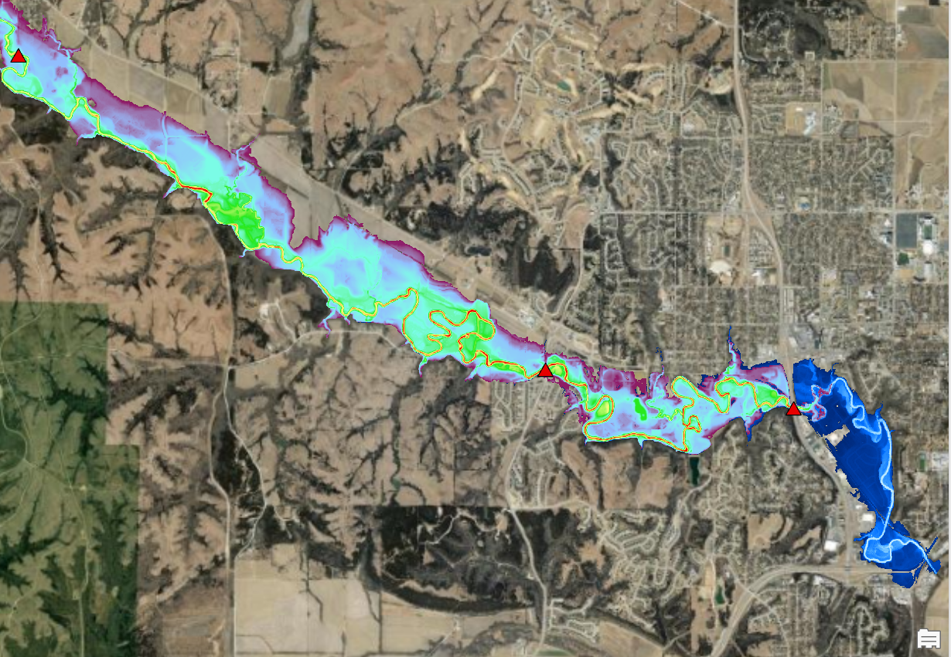
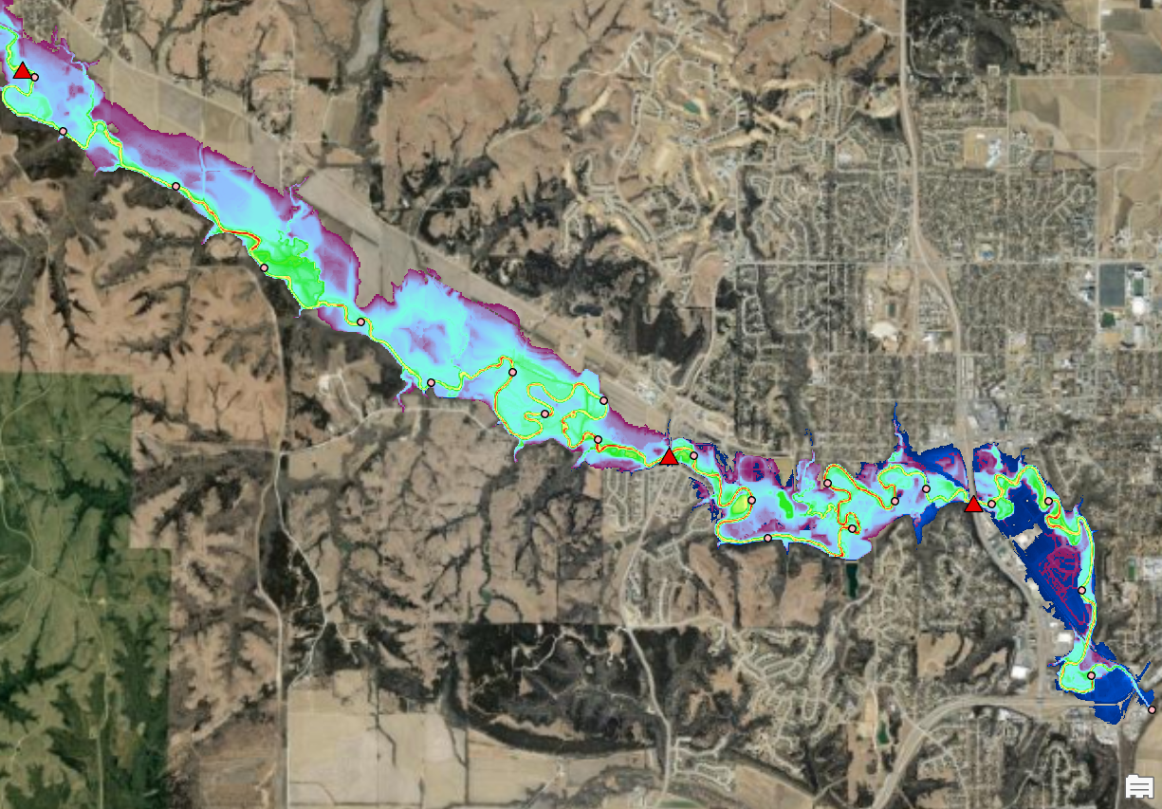
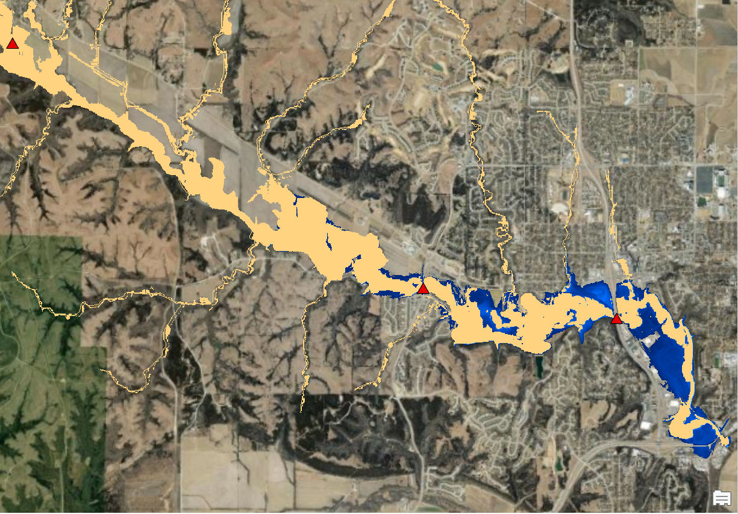
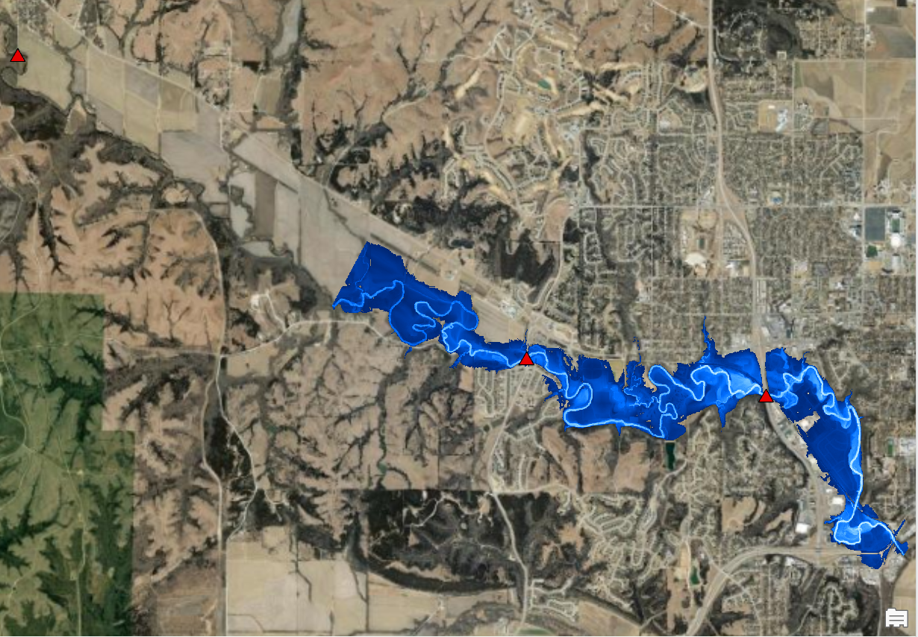
HAND and FLDPLN FIM with 10-m DEM

Slide 15
Mapping Wildcat Creek 2018 Labor Day Flood
Wildcat Creek data is on KU KBS-KARS server
DEM (GeoTIFF and BIL)
Gauge data
Reference inundation map
Segment shapefiles (not necessary but just in case)
Notebooks, Python packages and tools are on GitHub
Installer with MATLAB Runtime included is on KU KBS-KARS server

Slide 16
Prepare DEM
Hydro-condition DEM
No conditioning for the Wildcat DEM
Convert hydro-conditioned DEM (in GeoTIFF) into BILs
ArcGIS toolbox fldpln preprocess model.atbx
fldpln_pre_process_tool tool

Slide 17
Build the fldpln Python environment
00_build_fldpln_python_env.md
Major steps
Install miniconda and mamba
Create the fldpln environment using fldpln_windows.yaml
Install MATLAB runtime and the fldpln_py package
Install fldpln package
Install JupyterLab or VSC if necessary

Slide 18
Build segment-based Library
01_build_segment_library.ipynb
Major steps
Identify stream networks and generate segments
Select segments and prepare spatial mask
Create raw segment-based library
Reformat segment-based library
Generate stream order

Slide 19
Tile segment-based Library
02_build_tiled_library.ipynb
Major steps
Tile segment-based library
Calculate FSP and segment downstream distance
Assign stream order to FSPs and segments

Slide 20
Create Special Maps
03_mapping_special.ipynb
Four special maps
Minimum depth to flood map
Number of FSP map
Depression depth map
Constant FSP stage map (all the FSP has the same stage)

Slide 21
Map Flood Events
04_mapping_event.ipynb
Major steps
Prepare gauge stage elevation
Snap gauge to FSPs
Interpolate FSP stage
Create inundation depth map

Slide 22
Acknowledgements
Jude and graduate students @KU
James and Junho @UA
Funding
GIS-PB
Kansas Water Office (KWO) / KDEM
Contact
Xingong Li (lixi@ku.edu)

